Slide 1
Unintended Consequences
How to Reduce Exclusionary Practices In Our Organizations and Communities

Slide 2
Kim Crayton
#causeascene
@KimCrayton1
hashtagcauseascene.com
kimcrayton.com

Slide 3
Let’s Define Terms

Slide 4
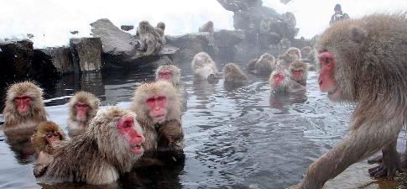
Privilege Is About Access
#causeascene
@KimCrayton1

Slide 5
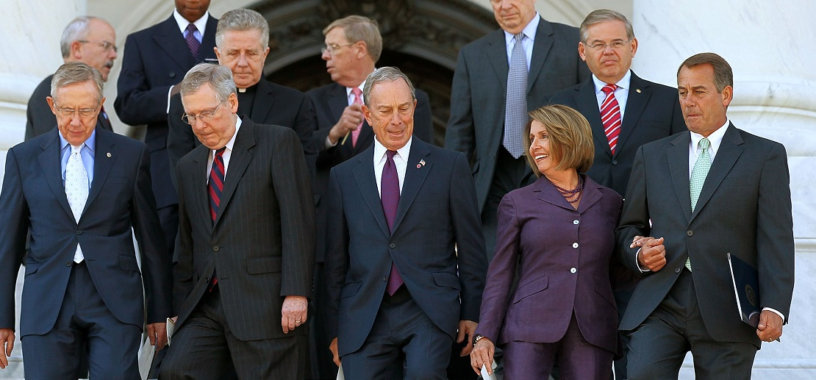
Underrepresented Is About Numbers
#causeascene
@KimCrayton1

Slide 6
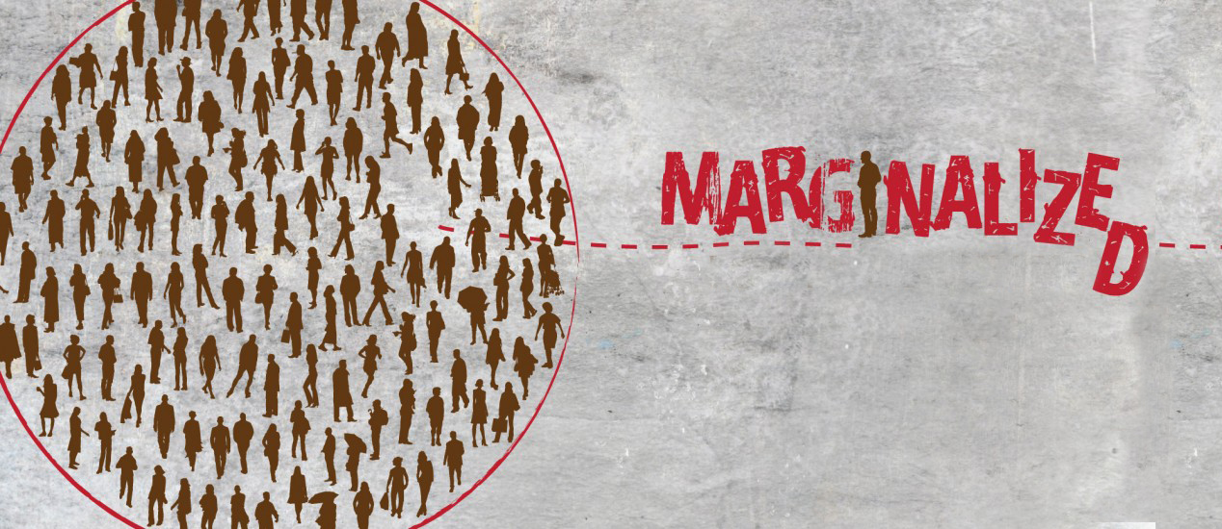
Marginalized Is About Treatment
#causeascene
@KimCrayton1

Slide 7
Diversity Is About Variety
#causeascene
@KimCrayton1

Slide 8
Inclusion Is About Experience
#causeascene
@KimCrayton1

Slide 9
Current Business Challenge #1
Inclusion != Equality
Inclusion != Quotas
Inclusion = Experience
#causeascene
@KimCrayton1

Slide 10
Current Business Challenge #2
Products and services are not businesses.
#causeascene
@KimCrayton1

Slide 11
Current Business Challenge #3
You cannot manage what you cannot measure.
#causeascene
@KimCrayton1

Slide 12
Building a successful organization, with fewer unintended consequences, requires more than a great product or service. It requires leaders being able to give all stakeholders the experiences they want and the ability to manage the process.
#causeascene
@KimCrayton1

Slide 13
All Stackholders
Level 1: Those who work for you;
Level 2: Those who partner with you;
Level 3: Those who buy from you;
Level 4: Those who invest in you.
#causeascene
@KimCrayton1

Slide 14
Going from product/service focused to business model focused takes time, intention, and strategic effort. All are necessary in order to innovate, differentiate, and compete in the Information Age.
#causeascene
@KimCrayton1

Slide 15
Also, building stakeholder rather than shareholder focused organizations is a proactive approach to addressing inclusion, diversity, and safe spaces in tech.
#causeascene
@KimCrayton1

Slide 16
Let’s Define
Some More Terms
#causeascene
@KimCrayton1

Slide 17
Racism
Racism = race prejudice + social and institutional power
Racism = a system of advantage based on race
Racism = a system of oppression based on race
Racism = a white supremacy system
Racism is different from racial prejudice, hatred, or discrimination. Racism involves one group having the power to carry out systematic discrimination through the institutional policies and practices of the society and by shaping the cultural beliefs and values that support those racist policies and practices.
http://www.dismantlingracism.org/racism-defined.html
#causeascene
@KimCrayton1

Slide 18
Bias
An inclination or prejudice for or against one person or group, especially in a way considered to be unfair.
Unconscious Bias
Any distortion of experience by an observer or reporter of which they are not themselves aware.
#causeascene
@KimCrayton1

Slide 19
Assumptions
An assumption is an unexamined belief: what we think without realizing we think it. Our inferences (also called conclusions) are often based on assumptions that we haven't thought about critically. A critical thinker, however, is attentive to these assumptions because they are sometimes incorrect or misguided. Just because we assume something is true doesn't mean it is.
https://library.louisville.edu/ekstrom/criticalthinking/assumptions
A thing that is accepted as true or as certain to happen, without proof.
#causeascene
@KimCrayton1

Slide 20
In order for assessments (assumptions) to be sound, they must be free of bias and distortion.
Validity
The quality of being logically or factually sound; soundness or cogency.
Reliability
The quality of being trustworthy or of performing consistently well.
#causeascene
@KimCrayton1

Slide 21
“People are having a field day with this pool float that looks like a pad.”
http://www.businessinsider.com/pool-float-looks-like-sanitary-pad-twitter-2017-7?IR=T
#causeascene
@KimCrayton1

Slide 22
“Fury at 'Bodega' tech startup that aims to put corner shops out of business.”
https://www.theguardian.com/technology/2017/sep/13/tech-startup-bodega-corner-stores
#causeascene
@KimCrayton1

Slide 23
“America has become so anti-innovation – it's economic suicide.”
https://www.theguardian.com/technology/2017/may/11/tech-innovation-silicon-valley-juicero
#causeascene
@KimCrayton1

Slide 24
When we talk about inclusion and diversity, we will never change how tech does business until we change how we define technical
Technology
The application of scientific knowledge for practical purposes, especially in industry.
Machinery and equipment developed from the application of scientific knowledge.
The branch of knowledge dealing with engineering or applied sciences.
Technical
Relating to a particular subject, art, or craft, or its techniques.
Of, involving, or concerned with applied and industrial sciences.
#causeascene
@KimCrayton1

Slide 25
It damages the health of our communities when programming is considered technical and everything else is non-technical i.e. “soft skills”. “Non-technical” content does not hold the same value in the minds and wallets of many members in our communities, especially decision makers. This kind of content is often seen as “filler” and unnecessary to the profession.
#causeascene
@KimCrayton1

Slide 26
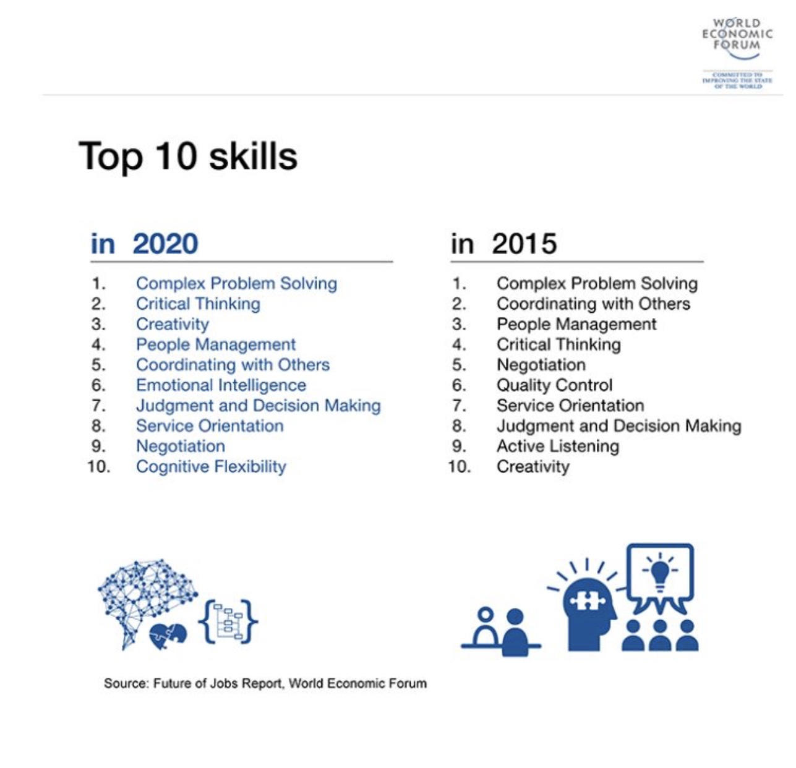
#causeascene
@KimCrayton1

Slide 27
To meet the needs of the 21st century organization, we must radically change how we recruit, hire, train, evaluate, and promote for the knowledge and skills needed.
#causeascene
@KimCrayton1

Slide 28
Although we often use the words interchangeably, being “intentional” and being “strategic” are two different things.
Intention
A thing intended; an aim or plan
Strategy
A plan of action or policy designed to achieve a major or overall aim.
#causeascene
@KimCrayton1

Slide 29
Although intention, by its very definition, is deliberate, there is no assurance of direction; forward movement.
#causeascene
@KimCrayton1

Slide 30
Intention is aiming at a target but strategy outlines your approach to ensuring that the target is hit.
#causeascene
@KimCrayton1

Slide 31
This is the difference between wanting a particular outcome and mapping out a route to ensure that you reach or get as close as possible to that outcome.
#causeascene
@KimCrayton1

Slide 32
Today’s business success is built on leaderships ability to consider a complex set of variables that at times can seem to be at odds with each other.
#causeascene
@KimCrayton1

Slide 33
These leaders must figure out how to optimally position their products and services, while also considering their environmental impact, pay equity, their ability to develop a diverse and inclusive culture, etc., all while being innovative and disruptive.
#causeascene
@KimCrayton1

Slide 34
This new level of complexity requires a strategic approach that is well-defined and flexible.
#causeascene
@KimCrayton1

Slide 35
Effectively doing business in the Information Age requires a diversity of perspectives in order to create products and services that meet the needs of global customers and clients.
#causeascene
@KimCrayton1

Slide 36
“It's Up to White Men to Improve Tech's Diversity, Says Uber Exec Bozoma Saint John”
She also characterized the notion that a lack of diversity stems from a lack of suitable female and minority job candidates as “bullshit.” Instead, she said, the problem was down to people on the hiring side sticking with what was familiar to them.
#causeascene
@KimCrayton1

Slide 37
Stop Creating Barriers to Entry
Treating all applicants the same is lazy
Stack Overflow and GitHub aren’t effective measures for identifying the needed knowledge and skills for success and it is lazy.
Whiteboarding doesn’t assess applicants ability to produce under “real-world” conditions and it is lazy
Expecting applicants to solve real organizational problems without pay is unethical and lazy
BOTTOM LINE: STOP TREATING APPLICANTS AS IF THEY ALL HAVE THE TIME, ENERGY, AND INTERESTS OF WHITE MEN AGE 18-34! IT IS LAZY!
#causeascene
@KimCrayton1

Slide 38
It’s about making changes to culture that reflect absorption (organizational) rather than an expectation of assimilation (individual)
#causeascene
@KimCrayton1

Slide 39
Many support the “idea” of diversity of thought but very few are capable of reaching any meaningful outcomes because most efforts are guided by intention alone.
#causeascene
@KimCrayton1

Slide 40
Without a thought out and tested strategy, well meaning individuals often find themselves having to face the consequences of an initiative that at best is unwelcoming and at worst, harms the very groups of underrepresented and marginalized individuals they seek to include.
#causeascene
@KimCrayton1

Slide 41
Efforts designed to improve the experiences of traditionally excluded populations is a process that requires patience, forethought, and a developed strategy that has considered how to counter for a system of privilege, bias, assumptions, racism, and outright discrimination.
#causeascene
@KimCrayton1

Slide 42
Success in these areas requires leaders to go beyond intention and opt for strategy or risk being the next organization, community or event to find itself dealing with the fallout when intention is not enough.
#causeascene
@KimCrayton1

Slide 43
Thank you!
#causeascene
@KimCrayton1

